Slide 1

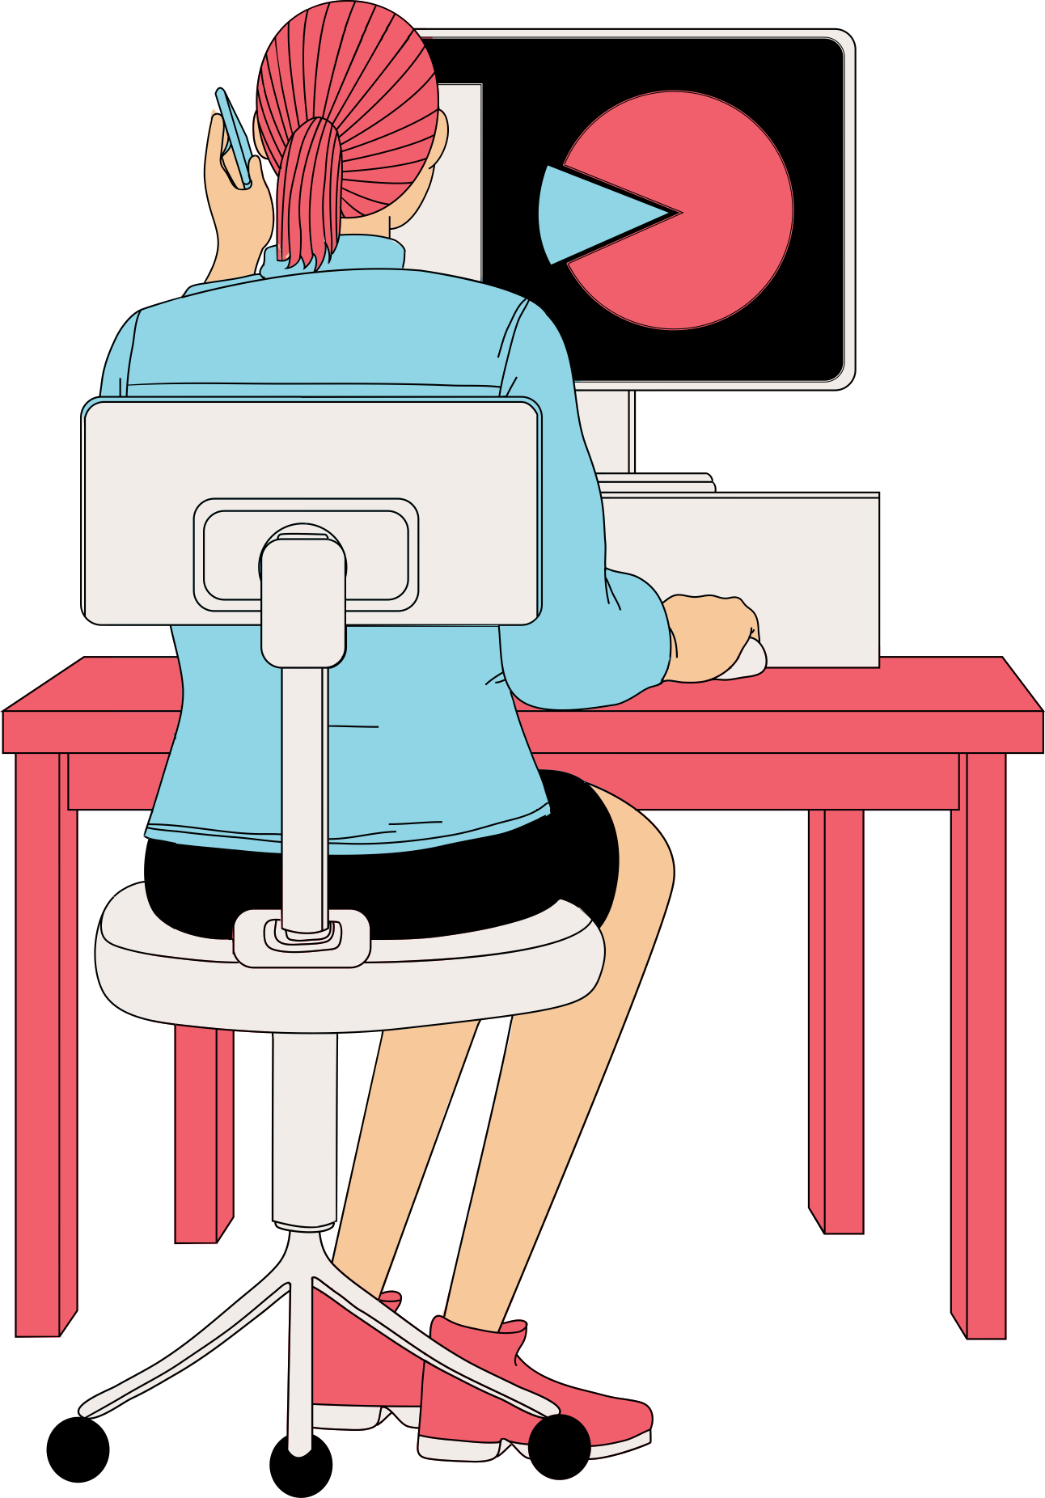
TECHNOLOGICAL LITERACY AMONG STATISTICS UNDERGRADUATES
Final Presentation
Statistics in Practice I
Group 2A

Slide 2
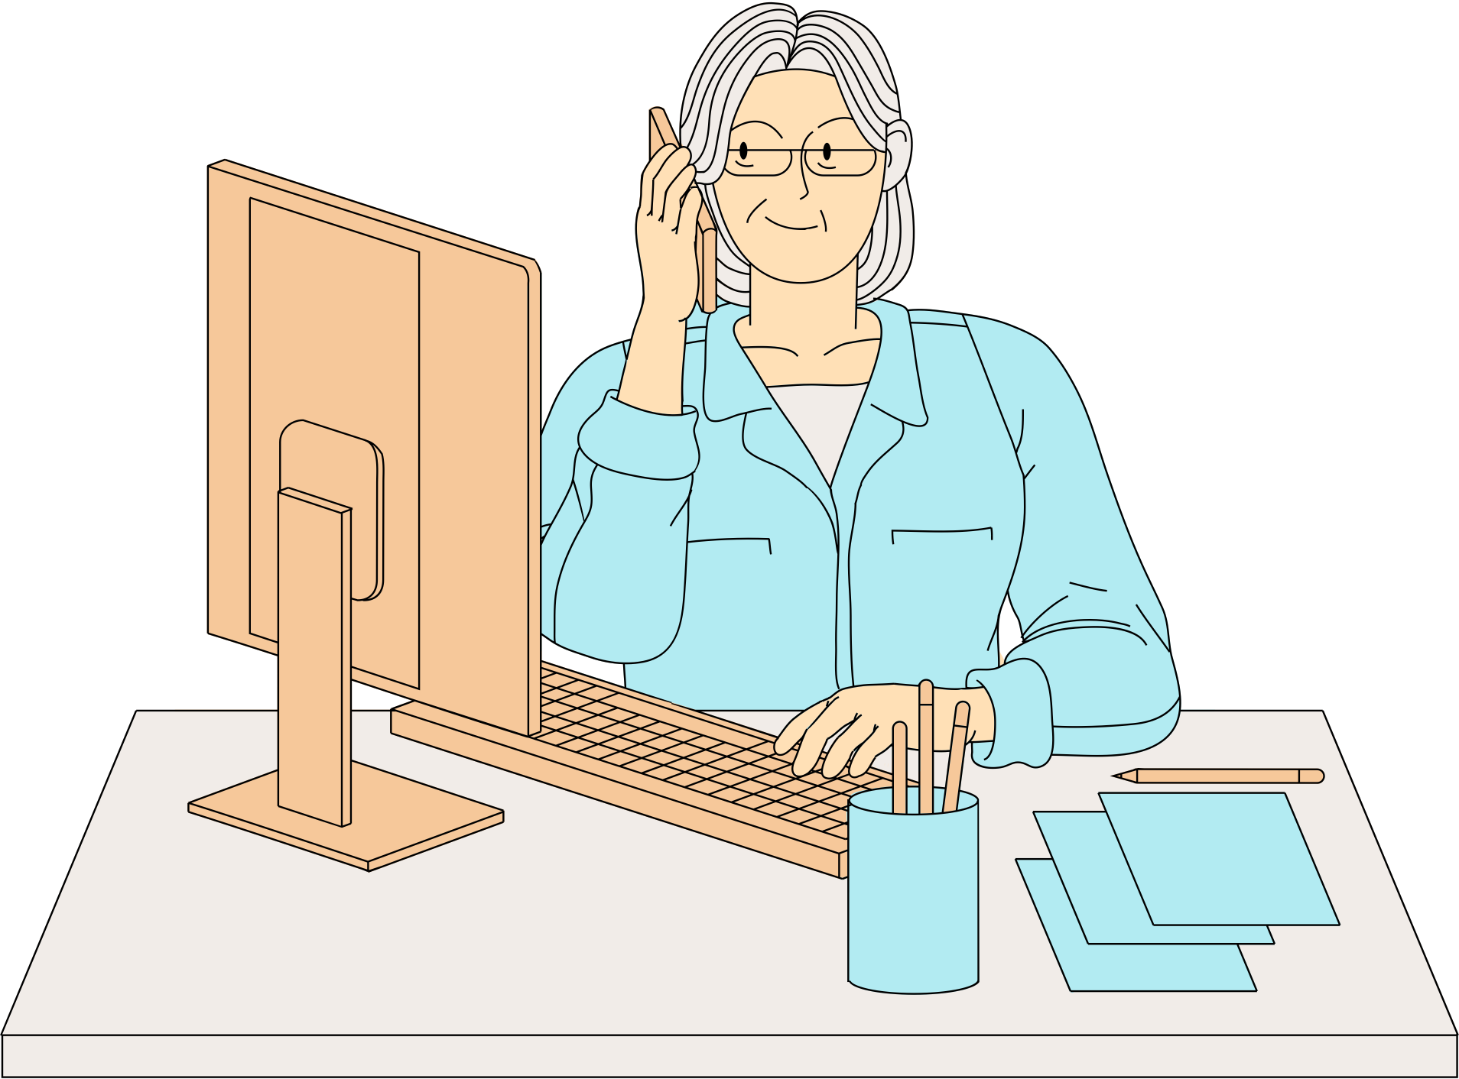
INTRODUCTION
We live in a technology-driven era with almost everything linked to it. However, one must be knowledgable enough to get the best advantage.
This study focuses on how the technological literacy associates with undergraduates from the stat department.
Significance :
This study allows us to identify how tech literacy is distributed among the undergraduates under different aspects.

Slide 3

INTRODUCTION CONTD.
Objectives :
To identify the most used statistical software by the statistics undergraduates.
To identify the usage of different Statistical Software for data cleaning, analysis and visualization by the specialization groups.
To compare the usage and proficiency in different types of software.
To determine the association of proficiency in different software with the GPA.
To determine the association of proficiency in different software with Gender

Slide 4
DATASET
Subset of variables extracted from the dataset collected through an online survey within the department with a target population of 105 undergraduates
54 observations with 30+ variables including both Qualitative and Quantitative type variables
Quantitative - GPA
Qualitative - Specialization, Gender, Statistical software used, Proficiency ratings, Usage ratings etc

Slide 5
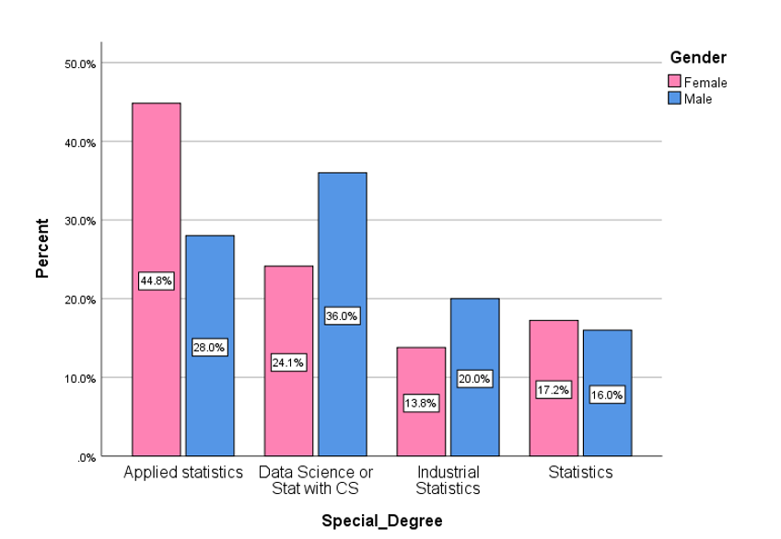
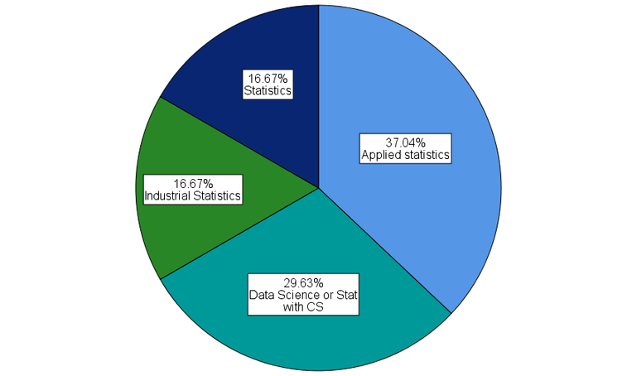

DESCRIPTIVE ANALYSIS

Slide 6
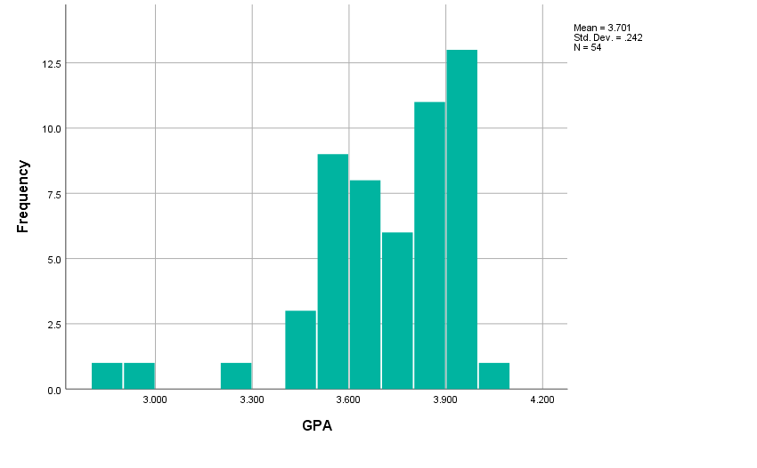
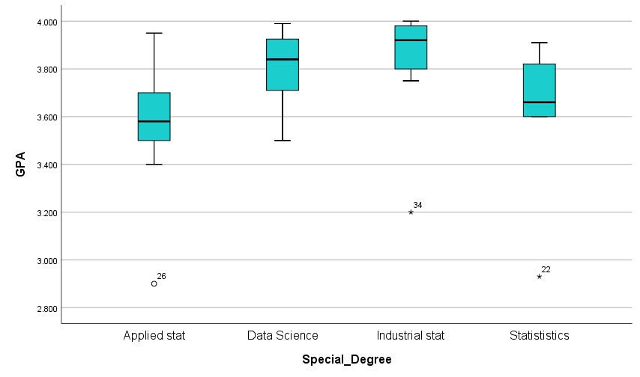
s
DESCRIPTIVE ANALYSIS CONTD.

Slide 7
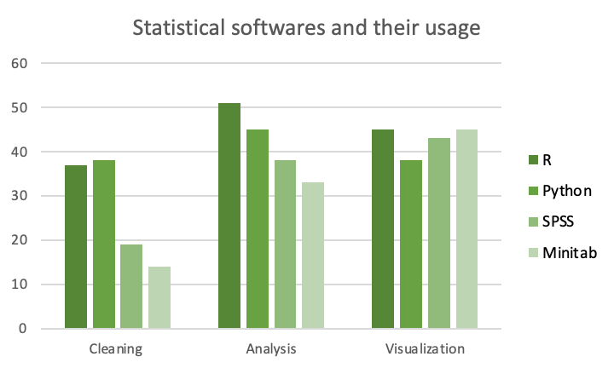
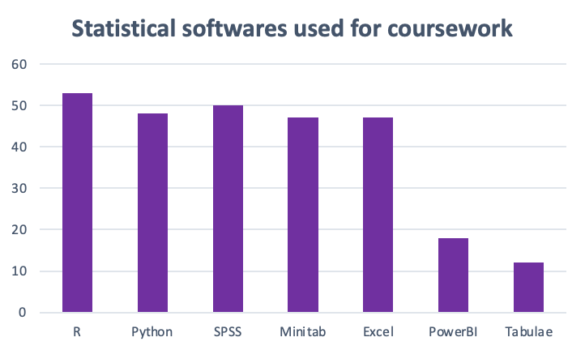
s
DESCRIPTIVE ANALYSIS CONTD.

Slide 8
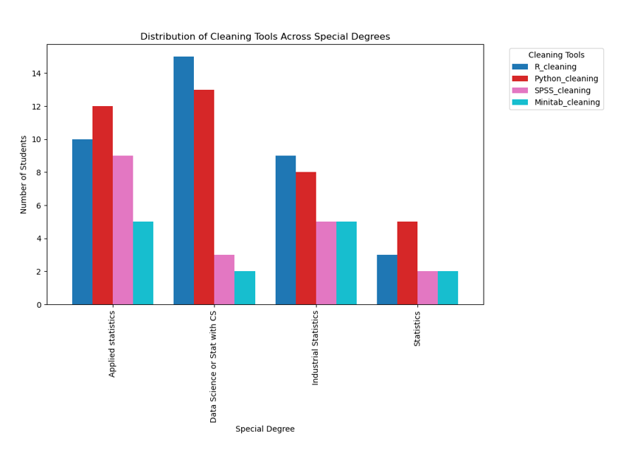
s
DESCRIPTIVE ANALYSIS CONTD.
Applied Statistics and Statistics students mainly use Python for cleaning, while those in Data Science or Statistics with CS, and Industrial Statistics programs show a preference for using R for this task.

Slide 9
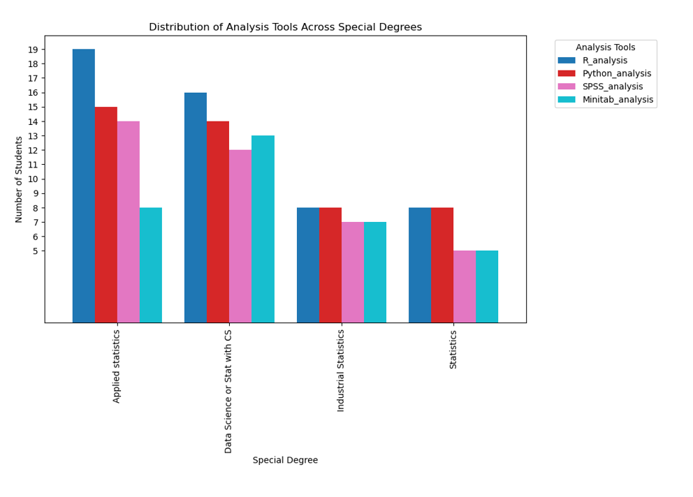
s
DESCRIPTIVE ANALYSIS CONTD.
Across all four degree programs, R software is the most popular choice for analysis.
Both Industrial Statistics and Statistics students show a dual preference, utilizing both Python and R software for their analytical tasks.

Slide 10
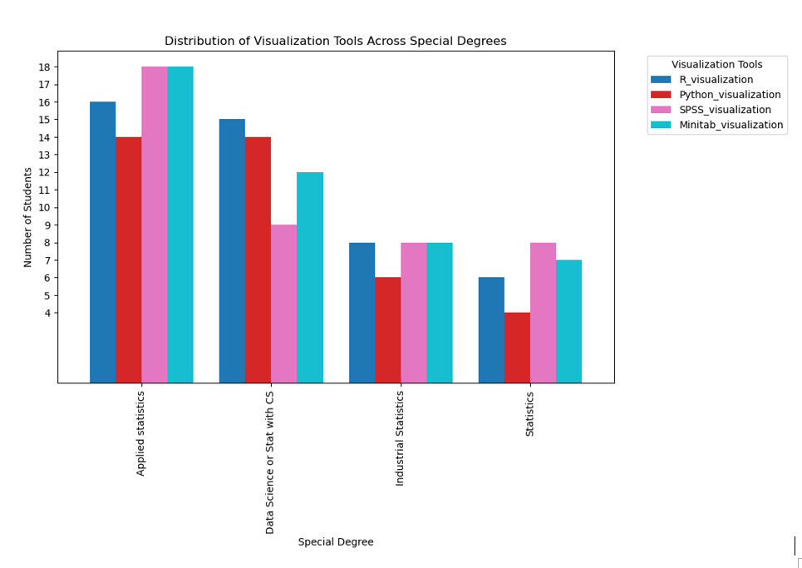
s
DESCRIPTIVE ANALYSIS CONTD.
In Applied Statistics, Industrial statistics and Statistics students mostly use SPSS and Minitab for visualization.
Data Science or Stat with CS students prefer R and Python for visualization purposes.

Slide 11
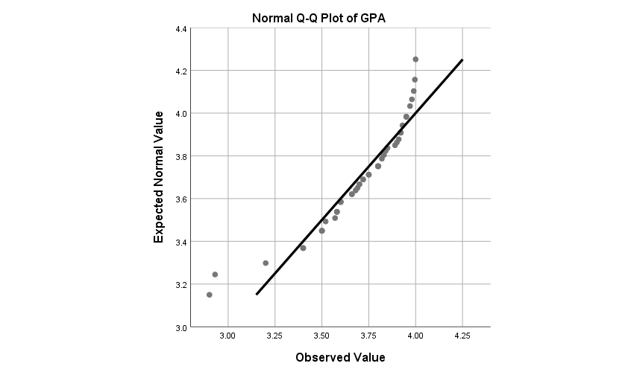
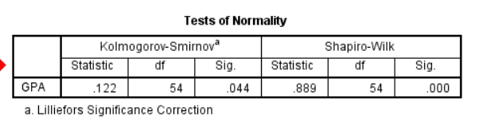
ss
ADVANCED ANALYSIS
Deviations in the Q-Q plot of GPA indicate the depatures from normality. And also, by using Shapiro-Wilk Test and KS Test, since the null hypothesis is rejected at 5% significance level, we can say that the GPA data is not normally distributed.

Slide 12
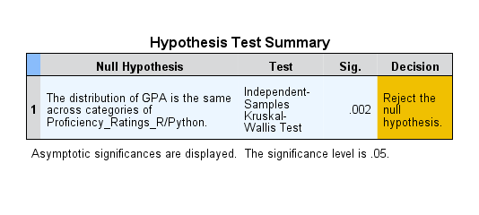
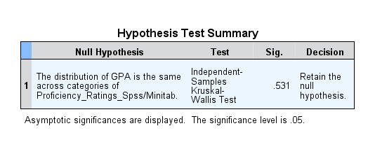
ADVANCED ANALYSIS CONTD.
1) Check the association between GPA value and Proficiency Ratings in Statistical Softwares (R/Python, SPSS/Minitab, Excel, Power BI/Tabuleau)
We can analyze this from the Kruskal-Wallis test. Then Hypothesis,
H0 = There is no difference in location among the GPA from which the proficiency ratings in statistical software been drawn
H1 =There is a difference in location among the GPA from which the proficiency ratings in statistical software been drawn
R/Python Software
Spss/Minitab Skills

Slide 13
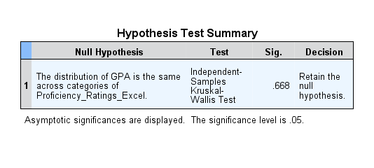
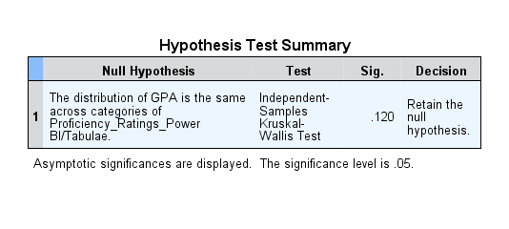
ADVANCED ANALYSIS CONTD.
Excel
Power BI/Tableau
In here we can see in Proficiency R/Python software only reject null hypothesis. Therefore we have enough evidence at conclude that 5% level of significance there is a difference in location among the GPA from which the proficiency ratings in R/Python statistical software been drawn. Except R/Python software all other software proficiency rates are no difference in location among the GPA .

Slide 14
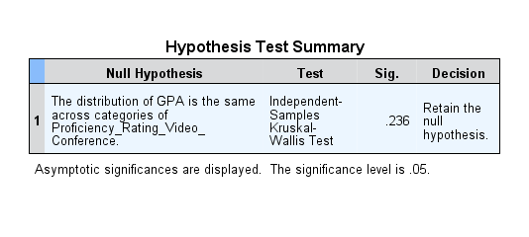
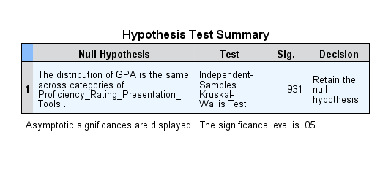
ADVANCED ANALYSIS CONTD.
2) Check the association between GPA value and Proficiency Ratings in Other Software tools (Presentation tools, Documentation tools, Google Apps, Video conference tools)
We can analyze this from the Kruskal-Wallis test. Then Hypothesis,
H0 = There is no difference in location among the GPA from which the proficiency ratings in software tool.
H1 =There is a difference in location among the GPA from which the proficiency ratings in software tool.
Video Conference tools
Presentation Tools

Slide 15


ADVANCED ANALYSIS CONTD.
Documentation Tools
Google Apps
In here we can see all software tools do not reject null hypothesis. Therefore we have enough evidence at 5% level of significance to conclude that there is no difference in location among the GPA from which the proficiency ratings in other software tool (Presentation tools, Documentation tools, Google Apps, Video conference tools).

Slide 16
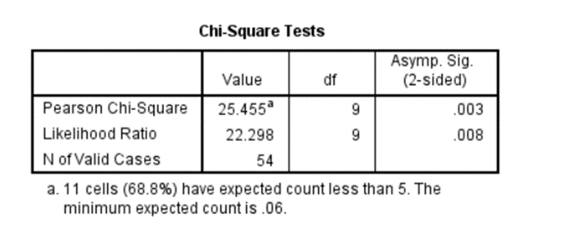
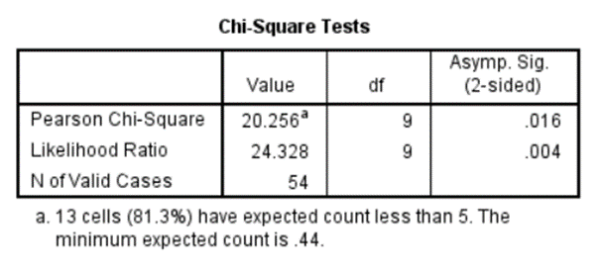
ADVANCED ANALYSIS CONTD.
3) Determine the association between the proficiency and usage in Statistical Software
We can check this by using Pearson Chi-Square test. Then Hypothesis is,
H0= There is no association between proficiency and usage in Statistical Software
H1= There is an association between proficiency and usage in Statistical Software
R/Python
Spss/Minitab

Slide 17
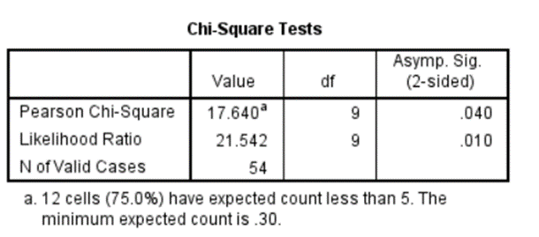
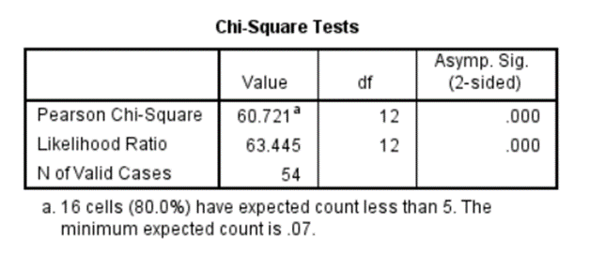
ADVANCED ANALYSIS CONTD.
Excel
Power BI/Tableau
Here we can see all four software tools Pearson chi square test p-value<significance level (0.05). Then we reject this null hypothesis. Therefore we have enough evidence at 5% level of significance to conclude that there is an association between proficiency and usage in Statistical Software. (Python, SPSS, Excel, Power BI/Tableau).

Slide 18
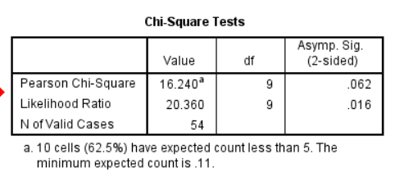
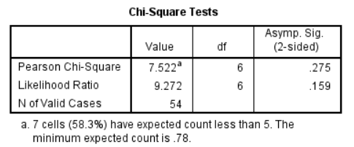
P
ADVANCED ANALYSIS CONTD.
4) Determine the association between the proficiency and usage in Other Software tools
We can check this by using Pearson Chi-Square test. Then Hypothesis is,
H0= There is no association between proficiency and usage in Other Software tool
H1= There is an association between proficiency and usage in Other Software tool
Presentation Tools
Documentation Tools

Slide 19
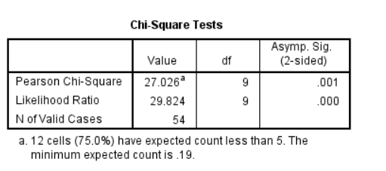
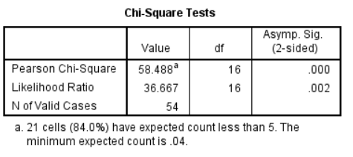
P
ADVANCED ANALYSIS CONTD.
Google Apps
Video Conferences
Here we can see only the Google Apps and Video Conferences software tools Pearson chi square test p-value<significance level (0.05). Then reject this null hypothesis in only Software tool Google Apps and Video Conferences . Therefore we have enough evidence at 5% level of significance to conclude that there is an association between proficiency and usage in Software tool Google Apps, Video Conferences and there is no association between proficiency and usage in Software tool Presentation tools, Documentation tools.

Slide 20
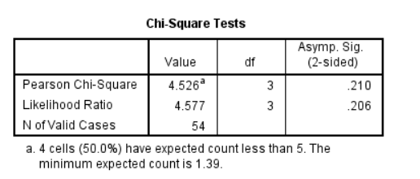
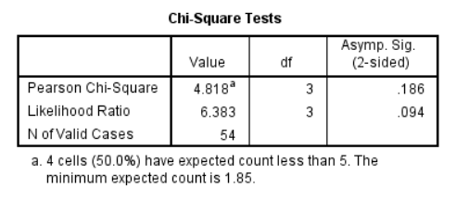
ADVANCED ANALYSIS CONTD.
5) Determine the association between the proficiency in Statistical Software with the Gender
We can check this by using Pearson Chi-Square test. Then Hypothesis is,
H0= There is no association between proficiency in Statistical Software with the Gender
H1= There is an association between proficiency in Statistical Software with the Gender
R/Python
Spss/Minitab

Slide 21
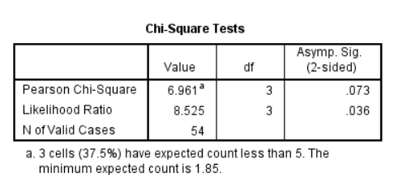
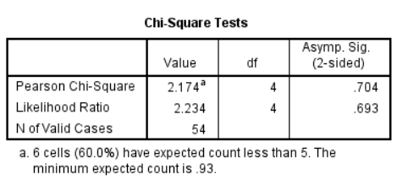
ADVANCED ANALYSIS CONTD.
Excel
Power BI/Tableau
Here we can see all statistical software Pearson chi square test p-value>significance level (0.05). Then we do not reject this null hypothesis. Therefore we have enough evidence at 5% level of significance to conclude that there is no association between proficiency in Statistical Software with the Gender.

Slide 22
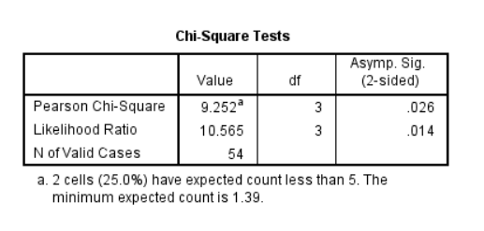
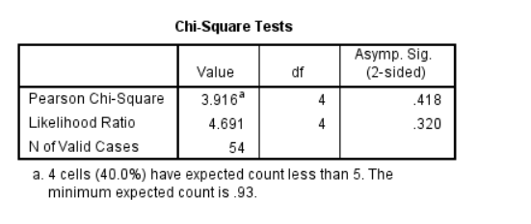
ADVANCED ANALYSIS CONTD.
6) Determine the association between the Proficiency in Software Tools with the Gender
We can check this by using Pearson Chi-Square test. Then Hypothesis is,
H0= There is no association between proficiency in Software tools with the Gender
H1= There is an association between proficiency in Software tools with the Gender
Video Conferences
Presentation Tools

Slide 23
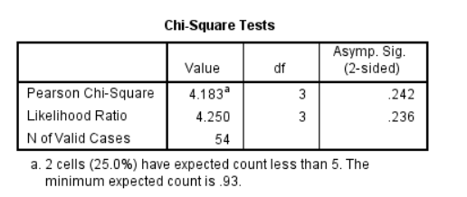

ADVANCED ANALYSIS CONTD.
Google Apps
Documentation Tools
Here we can see all software tools Pearson chi square test p-value>significance level (0.05) except presentation tool . Then we do not reject this null hypothesis for all software tools except presentation tool. Therefore we have enough evidence at 5% level of significance to conclude that there is an association between proficiency in Software tool presentation tool and there is no association between proficiency in Software tool Documentation tools, Google Apps, Video Conferences with the Gender.

Slide 24

CONCLUSIONS
Power BI and Tabulae was not used by the majority of the respondents unlike R, Python, Minitab and SPSS regardless the fact both of them being vastly used in the industry.
Each specialization tend to prefer one software over the others for data cleaning, analysis and visualization.
There’s a difference in GPA for different proficiencies in R/Python other statistical software did not show such tendencies.

Slide 25
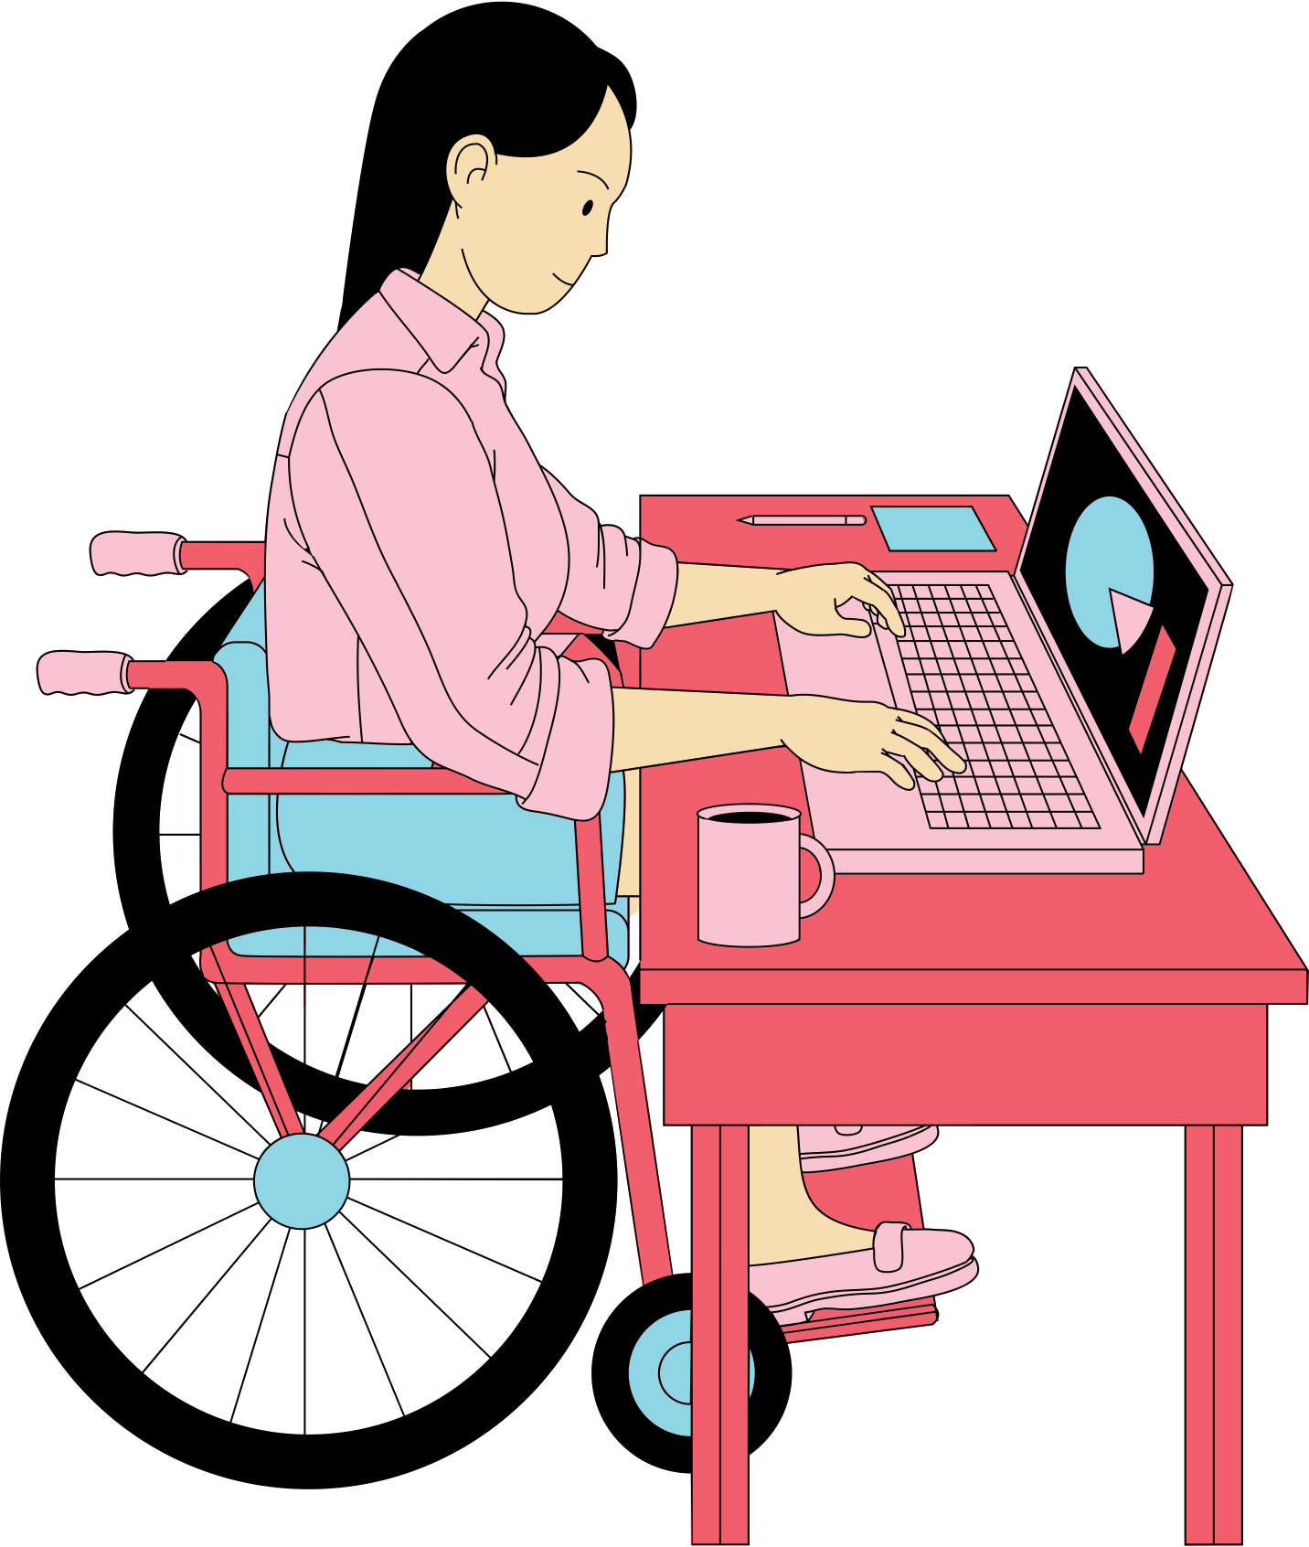
CONCLUSIONS CONTD.
Other software tools like Zoom, MS Office usage had no effect on the GPA which is used as the academic performance indicator.
There is an association between the usage and proficiency of statistical software.
Usage and the proficiency of video conferencing tools and google apps has an association but no such evidence for documenting and presentation tools.
Gender had no effect on the technological literacy of statistical software however there is an effect of gender on the literacy of presentation tools.

Slide 26
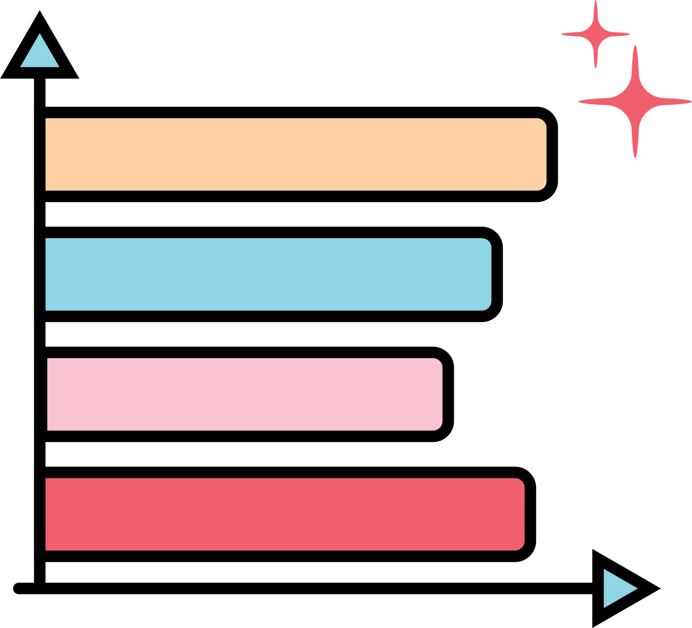
LIMITATIONS AND FUTURE WORK
LIMITATIONS
Convenience sampling of only 54 observations are used to identify associations present and majority belongs to Applied statistics which could lead to biased results.
Technological literacy is only measured through proficiency ratings in different software tools and their usage.
As the ratings are self scored they are not 100% reliable measurements.

Slide 27

LIMITATIONS AND FUTURE WORK
FUTURE WORK
Use of standard skill assessment methods instead of self scoring to measure the proficiency in different software.
Expand the target population to study how the tech literacy associate with academic performance of undergraduates in general.

Slide 28

THANK YOU!

